Slide 1


Insurance Charges Data Analysis
Final Data Analysis Project - Sekolah Data Pacmann
By : Stefanus Yudi Irwan
Date : Thursday 6th October 2022
pacmann.io
© 2022 – Pacmann AI
Notes:
Hello, my Name is Stefanus Yudi Irwan, for you today, I will explain my Data Analysis portfolio with Title “Insurance Charge Data Analysis”. I made this to fulfill my final project for Pacmann Data Academy in Indonesia in The Probability Course.

Slide 2
Outline
Introduction
Dataset
Descriptive Statistic Analysis
Categorical Variable Analysis
Continuous Variable Analysis
Correlation Variable Analysis
Hypothesis Testing
Analysis Conclusion
Notes:
The outline of this presentation comprises of 8 parts, the first is Introduction to the problem, next we will look at the dataset, going into the analysis there will be comprises of 5 analysis part which is Descriptive statistic, categorical variable, continuous variable, correlation variable, and the last is hypothesis testing. Then we will end this analysis by conclusion

Slide 3
Introduction
Notes:
First lets we talk about the problem

Slide 4
Introduction
Insurance companies need to take into account every aspect of the client’s data to determine the proper price of the client’s insurance payment.
This insurance payment from the clients will be needed to pay for health bills to the healthcare facility (ex. hospital, clinics).
Supervisors of a new insurance agency need help to know how is the user’s condition related to the insurance price. He has some data regarding the user’s condition and the insurance price in some regions.
Notes:
Insurance companies need to account for every aspect of client data to determine the insurance price or insurance charges
This insurance payment needed to pay for health bills to a healthcare facility
A supervisor of a new insurance agency needed help from me to know how is the user’s condition related to the insurance price. And he has some data regarding the user condition and the insurance price in some regions

Slide 5
Dataset
Notes:
Next we will talk about the dataset for this insurance charge analysis

Slide 6
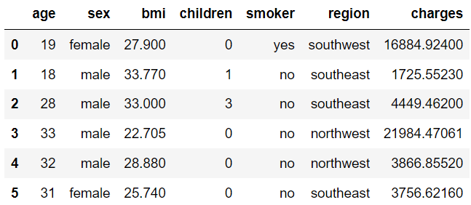
Dataset
Dataset comprises 7 columns and 1338 rows
There are 3 categorical data: Gender, Smoker, and Region
There are 4 numerical data: Age, BMI, Children, and Charges
Notes:
The dataset comprises of 7 columns and 1338 rows, we have three categorical data which is sex or gender, smoker that explain if the person are smoking or not, and region. Then we also have 4 numerical data which is age, Body Mass Index or BMI, total children in a family and insurance charges.

Slide 7
Descriptive Statistics Analysis
Notes:
First analysis we will look at the central tendencies of the data through descriptive statistics analysis

Slide 8
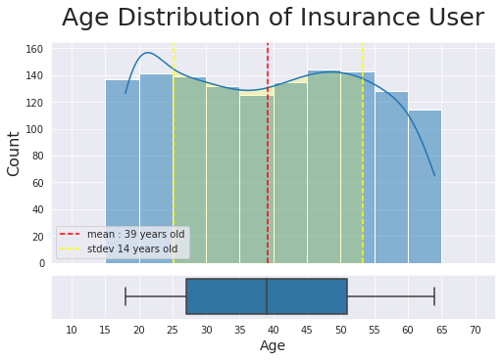
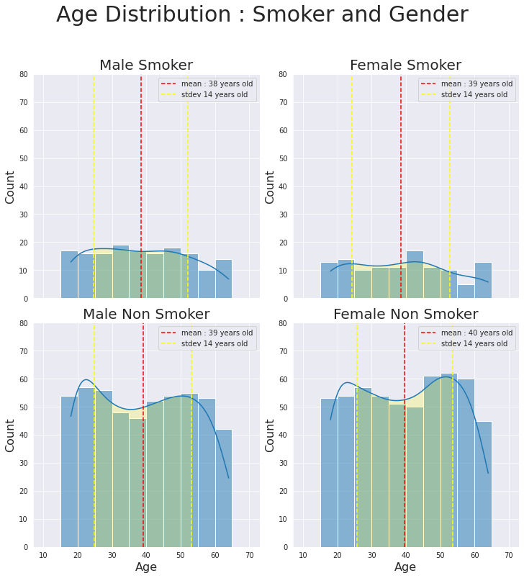

Analysis on Age
Insight.
Insurance user age ranged from 25 – 51 years old.
Smoker and gender variable are not affecting age central tendencies.
The average age of females is larger than the average age of males by one year.
Smoker people proportion is less than non-smoker people proportion.
Notes:
Analysis on age shows us that, Insurance user ages ranged from 25-51 years old, and after separation by Smoker and gender category the central tendencies do not change much from the beginning.

Slide 9
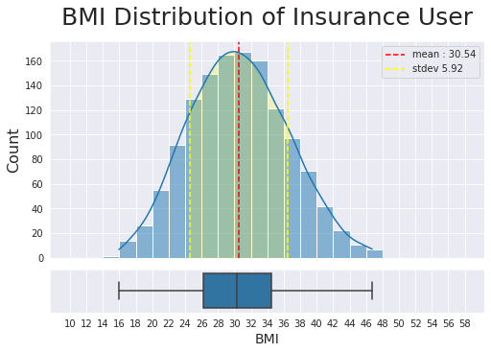
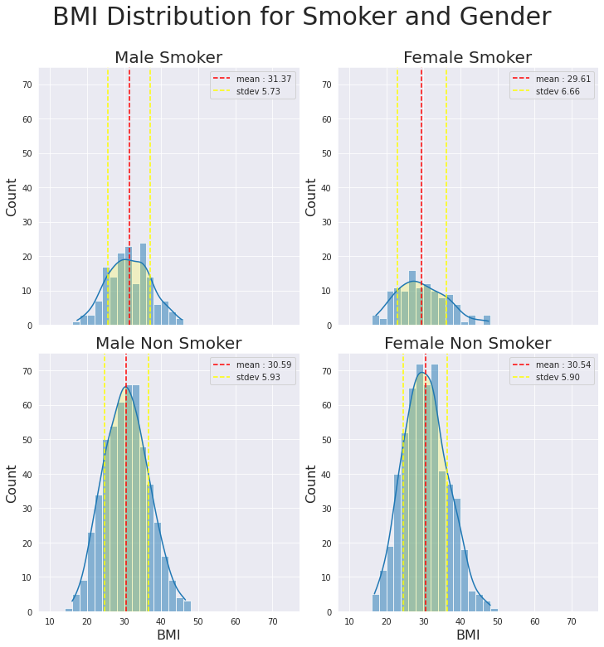
Analysis on BMI
Insight.
BMI of Insurance users is ranged from 24.62 – 36.46.
Smoker and gender variable are not affecting BMI central tendencies.
The mean of insurance users lies in BMI Obese category.
Notes:
Analysis of BMI shows us that the Mean BMI of insurance users lies in BMI obese category, same as age after separation by smoker and gender variables are not affecting BMI central tendencies

Slide 10
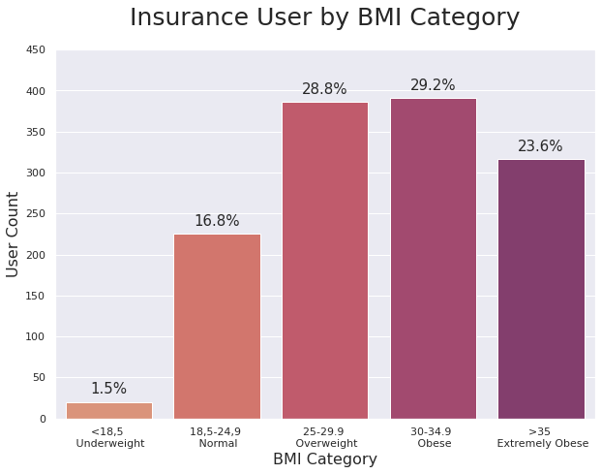
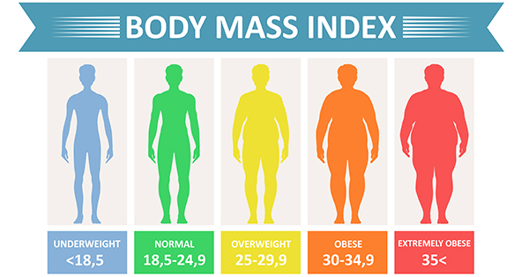
Analysis on BMI
Source : www.cdc.gov
81,7% of insurance users is having a BMI of overweight to extremely obese. this is the cause why the BMI average of males, females, smokers, or non-smokers has an obese value.
Insight.
Notes:
This part of the BMI analysis shows us that 81,7% of the insurance are overweight to extremely obese, this is the cause why the BMI average lies on the obese value

Slide 11
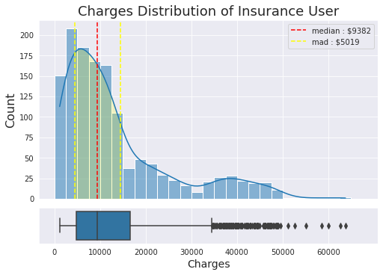
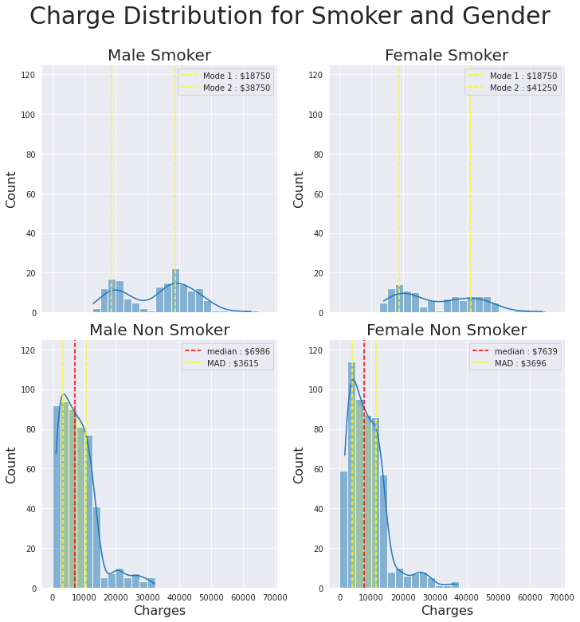
Analysis on Charges
Insight.
Overall insurance charges value is around $4363 - $14401.
Smoker insurance charges are more expensive than non-smoker insurance charges. The central tendency of smoker insurance charge value is absolutely larger than $18000, whereas the central tendency of non-smoker insurance charge is less than $10000.
For non-smoker people, Female insurance charges are more expensive than male insurance charges, but the difference is not larger than $1000.
Notes:
This analysis on charges show us that by comparing the central tendencies smoker insurance charge are more expensive than non smoker insurance charges, mode of smoker charges is larger that 18000 dollar, whereas non smoker less than 10000 dollar

Slide 12
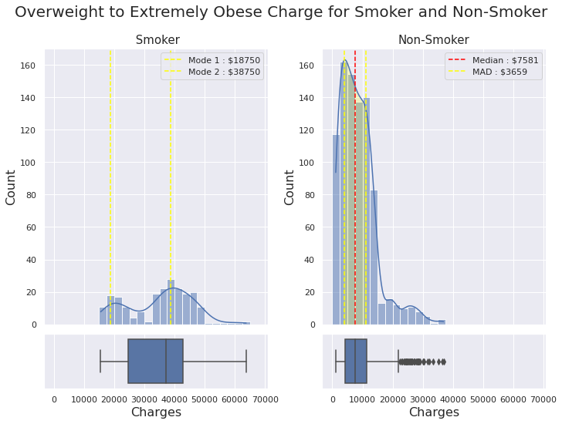
Analysis on Charges
Insight.
despite of BMI value, smoker insurance charges is still more expensive than non-smoker insurance charges.
Notes:
This part of analysis show us that without regarding to BMI, smoker insurance charge is more expensive than non-smoker

Slide 13
Descriptive Statistic Analysis Summary
Insurance users come mainly from productive people, with age values ranging from 25 to 51 years old, with an average value of 39-40 years old. The unique part, is those productive people have an average value of BMI around 30 which lies in the category of Obese. After further analysis, I found that 87,1% of the insurance user is having BMI from Overweight to Extremely Obese. This insurance user also covers people who smoke and don’t smoke. Because of their habits, the insurance charge of those people will vary, the most expensive group of insurance user charges comes from those who smoke. The insurance charges for smokers are much more expensive than for non-smokers. The charges values for smokers are larger than $18000 while charges for non-smokers are less than $10000.
Notes:
The summary is Insurance user comes mainly from 25-51 years old. 87,1% of them have an average value of BMI around 30. The most expensive group of insurance users comes from smoker people with charges for more than 18000 dollars while charges for a non-smoker is just 10000 dollar

Slide 14
Categorical Variables Analysis
Notes:
Next we will look at the categorical variable analysis

Slide 15
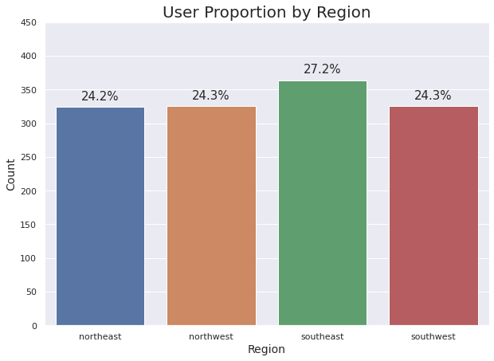
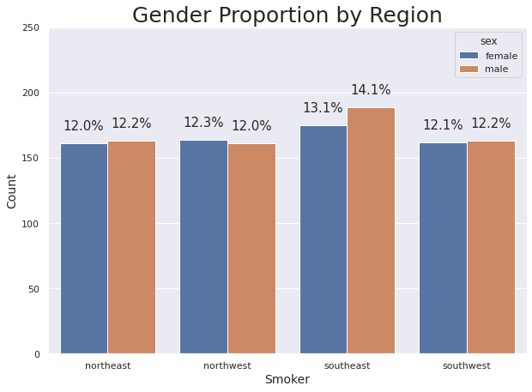
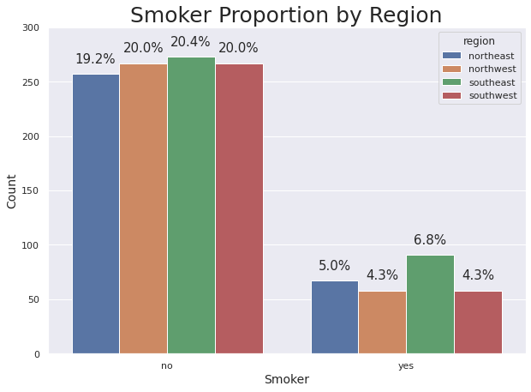
Region Analysis
Insight.
Northwest, southwest, and northeast has the same proportion of user, bar plot showed that the value is 24.2% - 24.3%, whereas the southeast has the largest proportion at 27.2%.
Every region nearly has a 50:50 female to male ratio, except the southeast with a difference of 1% in gender proportion.
In every region proportion of non-smokers is larger than the proportion of smokers. The ratio of smokers to non-smokers is around 1:4.
Southeast has the largest proportion of smoker compared to other regions, whereas northwest and southwest has the same head count of smokers.
Notes:
This part of the region analysis shows us that there is nearly even distribution of people in every region, there is also nearly even distribution of gender for every region, and a nearly even distribution of smoker, and non-smoker people in every region. A slight difference exists in the southeast region. Also, the ratio of smokers to non-smokers people is 1:4

Slide 16
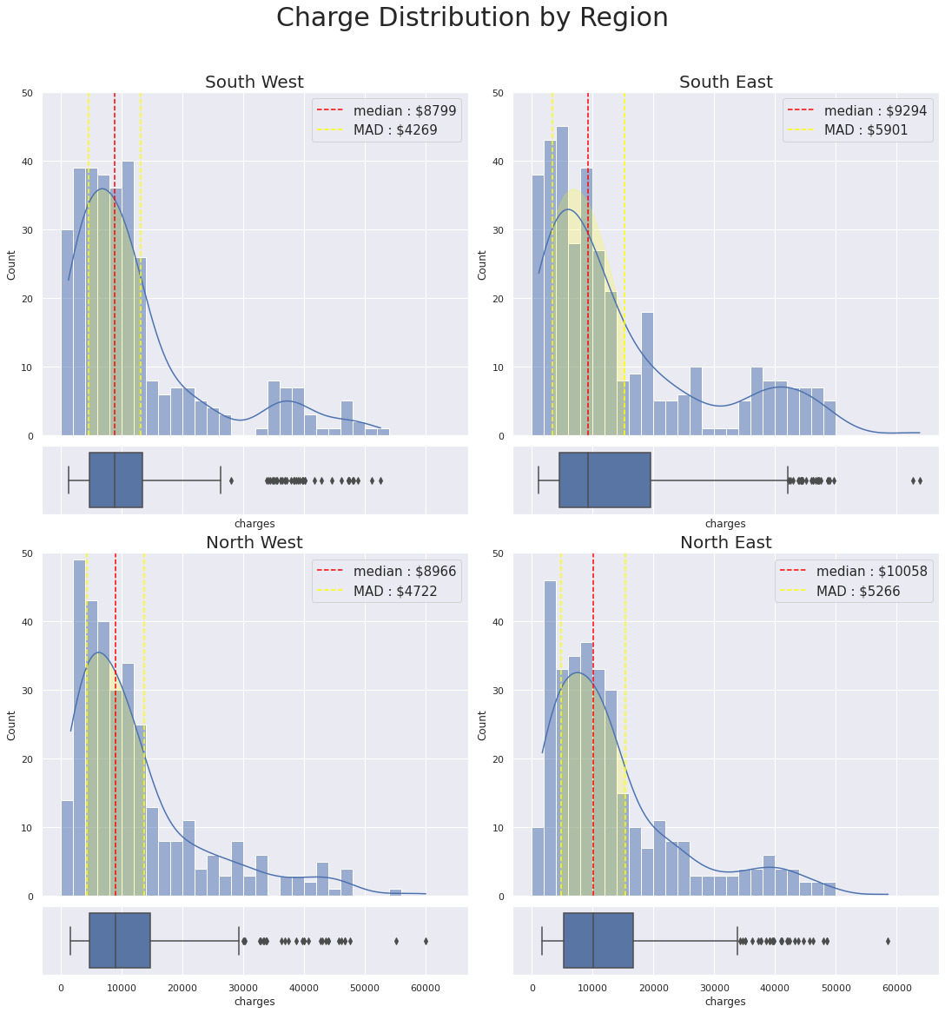
Region Analysis
Insight.
Distribution charge from every region shaping similar shape, positively skewed distribution.
North East became the most expensive charges with median $10058, and southwest became the cheapest charges with median $8799.
Notes:
This part of the region analysis showing us that all charges distribution are positively skewed for every region, and the most expensive charges is at northeast for around 10000 dollars while the cheapest charge is at the southwest of around 8800 dollars

Slide 17
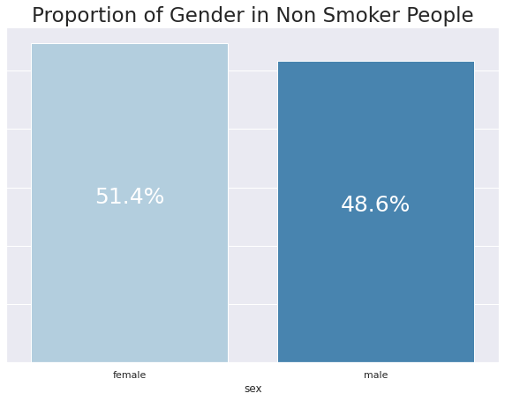
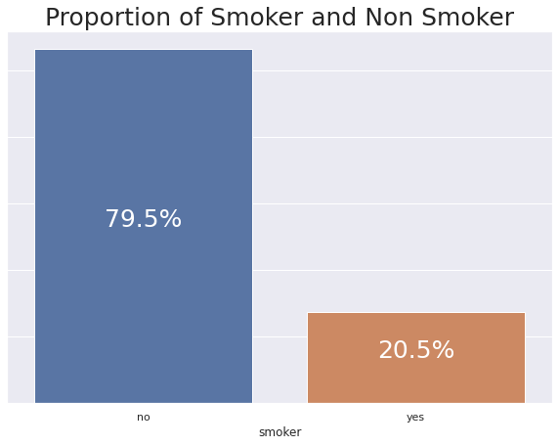
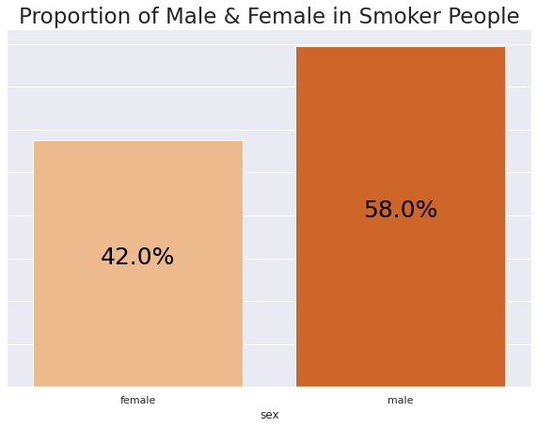
Smoker and Gender Analysis
Insight.
Smoker proportion is much smaller than non-smoker proportion, 20.5% compare to 79.5%.
In the smoker group, the male has the largest proportion 58% compared to female 42%.
In non-smoker group, female has the largest proportion 51.4% compared to male 48.6%.
Notes:
This smoker and gender analysis show us that 20.5% of insurance users are smokers and there is more male who smokes. Also, 79.5% of insurance users are non-smoker and there are more females than male

Slide 18
Categorical Variable Analysis Summary
Every region has a nearly equal amount proportion of insurance users, 24.2-24.3%, a slight difference exists in the southeast region with a proportion of 27,2% of all insurance users. Every region also has a nearly equal amount of gender proportion between male and female, 50:50, a slight difference also exists in the southeast region with a proportion difference of 1% between male and female. The data confirm that the proportion of smoker people is less than non-smoker people, the ratio of the smoker and non-smokers in every region is around 1:4. Within smoker people, the male proportion is larger than female, 58% compared to 42%, while in non-smoker people, the female proportion is larger than male, 51.4% compared to 48,6%. The northeast region became the region with the relatively expensive amount of insurance charge of around $100508, whereas the southwest region become the cheapest region with an insurance charge of around $8799.
Notes:
The summary is every region has a nearly equal amount of insurance users, gender, smoker, and smoker, and the proportion of smokers to non-smokers is 20.5% compared to 79.5%,
a slight difference exists in the southeast region.
All charges in every region are positively skewed with the northeast becoming the most expensive region with charges of around 10000 dollars
and the southwest region being the cheapest region with charges of around 8800 dollars.

Slide 19
Continuous Variables Analysis
Notes:
Next we will examine the probability through continuous variable analysis

Slide 20
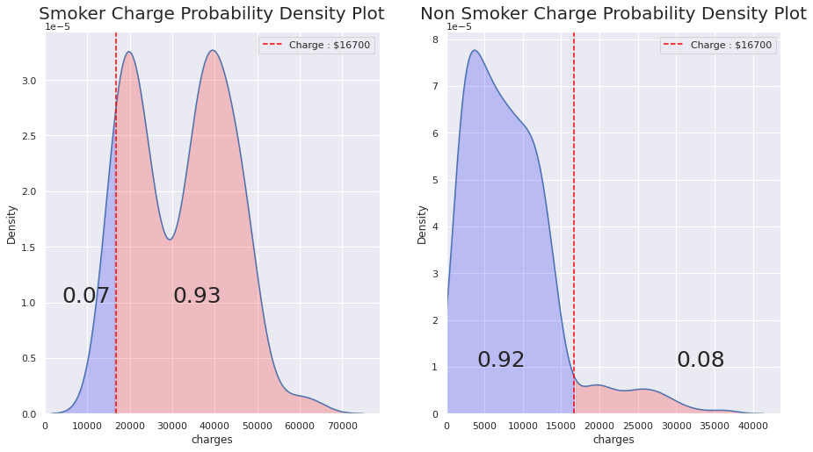
Smoker Probability Charge Analysis
It is very possible for smokers to get insurance charges more than $16700, the probability is 0.93. And it is rare that smokers will get insurance charges below $16700, the probability is just 0.07.
Insight.
it is rare for non smokers to have an insurance charge for more than $16700. But it is common for non-smoker to have insurance charges below $16700, the probability is 0.92.
Notes:
This analysis shows us that
smoker will have a probability of 0.93 to have an insurance charge for more than 16700 dollars,
while non-smoker just 0.08,
This is very distinct probability value from smoker and non smoker

Slide 21
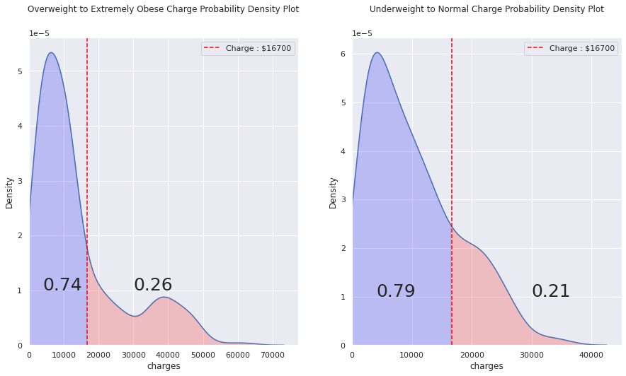
BMI Probability Charge Analysis
It is more possible for people with BMI >= 25 (Overweight to Extremely Obese) to get the insurance charge below $16700 because the probability is 0.74.
Insight.
Also It is more possible for people with BMI < 25 (underweight to normal) to get an insurance charge below $16700 because the probability is 0.79.
Notes:
This analysis shows us that
By comparing people with low BMI and high BMI.
People with a High BMI have a probability of 0.26 to get an insurance charge for more than 16700 dollars,
while people with a normal BMI is 0.21.
This value difference is not so significant as smoker

Slide 22
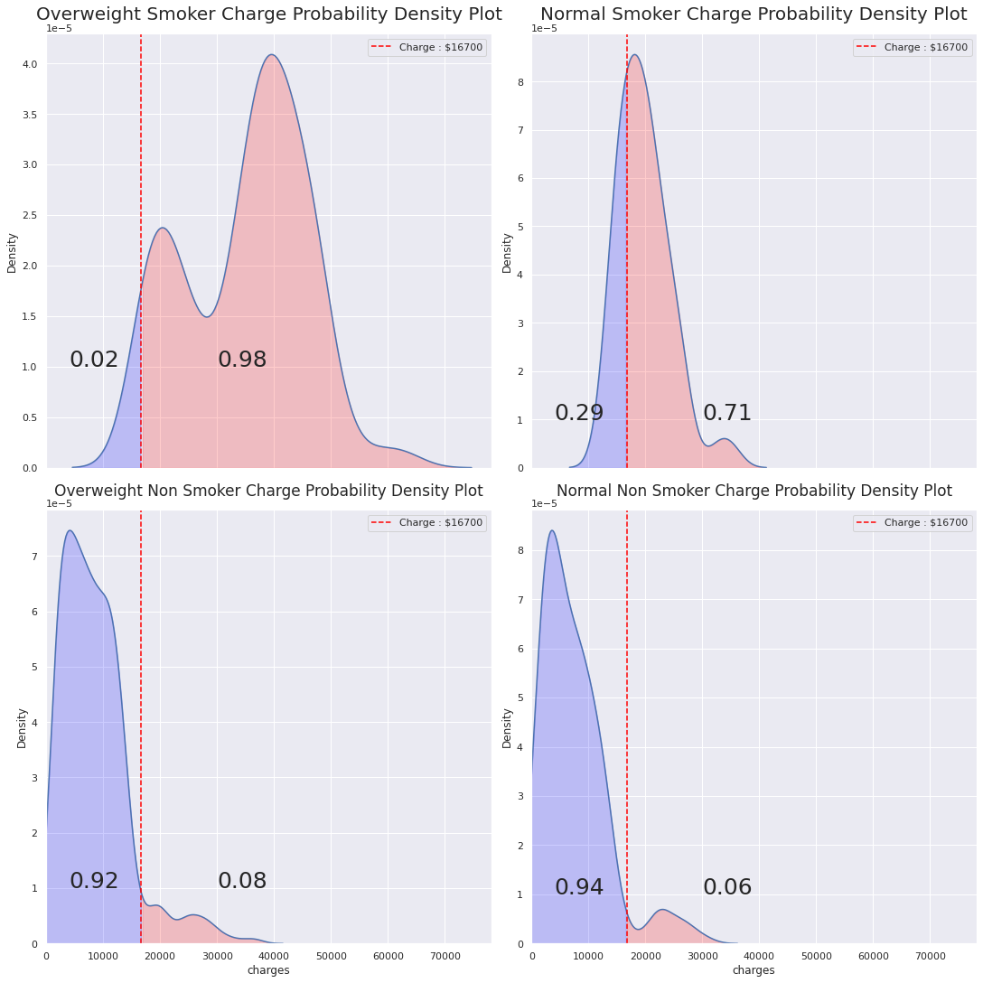
Smoker and BMI Probability Charge Analysis
Insight.
smoking really increases the probability of a person getting an insurance charge for more than $16700.
overweight also increases the probability to get an insurance charge for more than $16700 but not as strong as smoking.
Notes:
This combined analysis between smoker and BMI still show us
that smoker is strong factor that make the insurance charge is expensive compare to BMI

Slide 23
Continuous Variable Analysis Summary
The probability of a smoker getting an insurance charge of more than $16700 is very large, more than 0.7, without taking into account his/her BMI factor. BMI Factor also contributes to the expensiveness of insurance charges, but the effect is not as strong as if he/she smokes. For smokers, the difference of probability between a normal BMI smoker, and with overweight BMI smoker is 0.27, while for non-smokers the difference of probability between a normal BMI smoker, and with overweight BMI smoker is just 0.02, this difference is very significant, thus smoking is a great factor affecting the insurance charges.
Notes:
The summary is,
the probability of a smoker getting insurance charges for more than 16700 dollars is very large more than 0.7,
BMI also becomes the contributing factor
for the probability of a person
to get expensive insurance charges
but not as large as smoking

Slide 24
Correlation Analysis
Notes:
Next we will talk about the correlation between variables

Slide 25
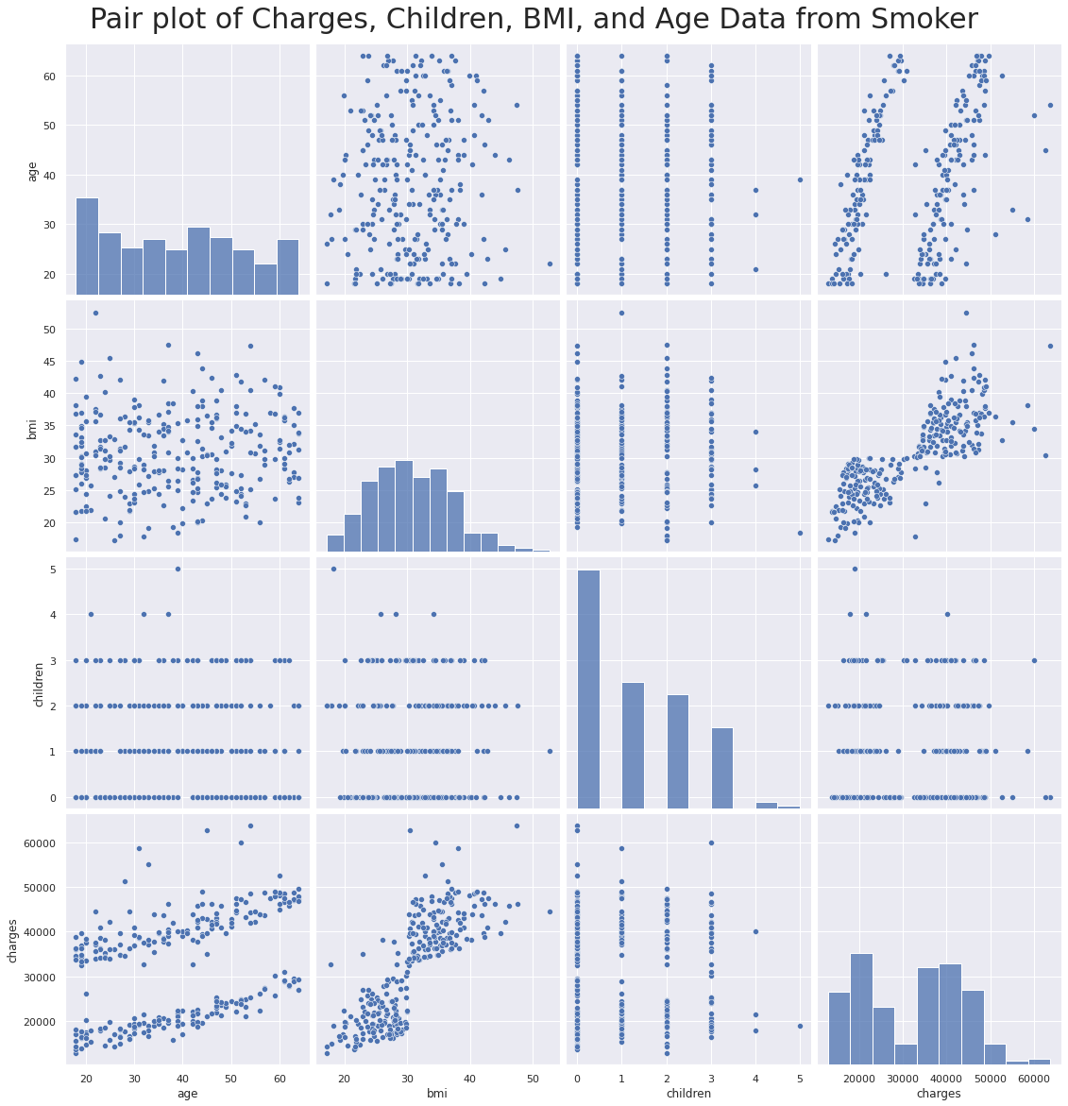
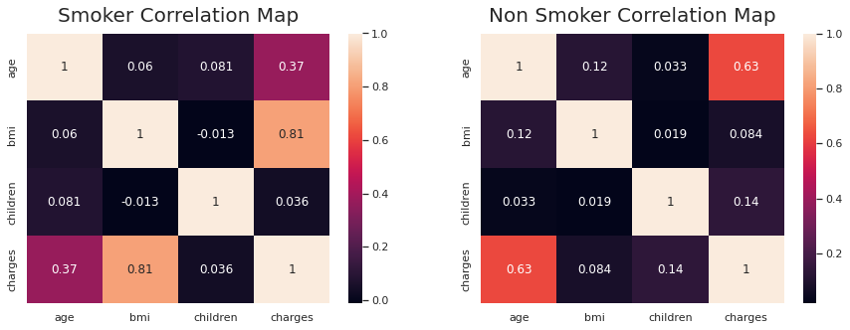
Smoker Correlation Analysis
Insight.
BMI and Charge has a strong correlation, 0.81.
there are positive weak correlation, 0.37, between age and charges, but notice there are pattern in the scatter plot
Notes:
This smoker correlation analysis shows us that
there is high correlation between BMI and charges, also there are some pattern in age and charges

Slide 26
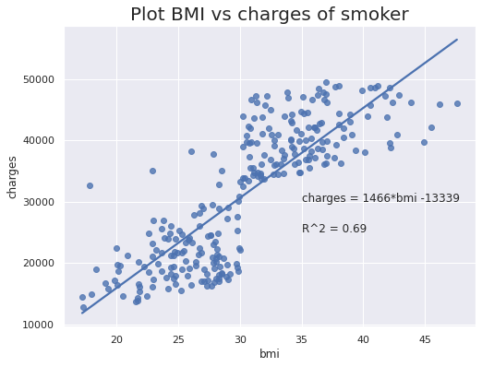
Smoker Correlation Analysis
Insight.
For smoker if the BMI of insurance user increase by one value, the charges will increase by $1466
Notes:
Dig deeper into smoker correlation analysis and create regression line,
we know that if the BMI of insurance user increase by one value, the charges will increase by $1466
One thousand four hundred and sixtysix dollars

Slide 27
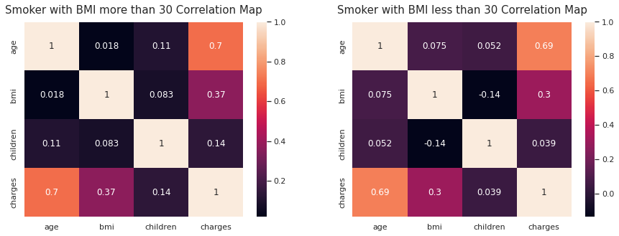
Smoker Correlation Analysis
After separation using BMI = 30 we could see that the correlation value from age and charge increased to 0.7, this is a strong correlation. This could mean that there are indeed a relationship between age and charges.
Insight.
Notes:
Separating smoker data by BMI equal to 30 we get a high correlation for age and charges for both BMI less than 30 and BMI more than 30.

Slide 28
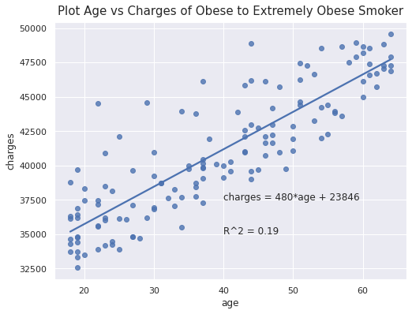
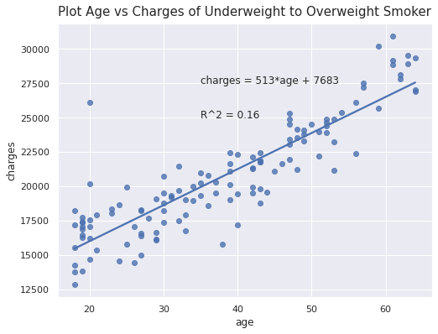
Smoker Correlation Analysis
Insight.
For smokers with BMI > 30, if the age was increased by one value, there will be an increase in insurance charges by $480. With charges ranged from $32500 to $50000.
For smokers with BMI <= 30, if the age was increased by one value, there will be an increase in insurance charges by $513. With charges ranged from $12500 to 32500. This finding confirms analysis before, people who smoke and have a high BMI tend to have an expensive insurance charge.
Notes:
Dig deeper into smoker correlation analysis and create regression line, we found that for BMI more than 30,
if the age was increased by one value, there will be an increase in insurance charges by $480,
and for BMI < 30 if the age was increased by one value, there will be an increase in insurance charges by $513.

Slide 29
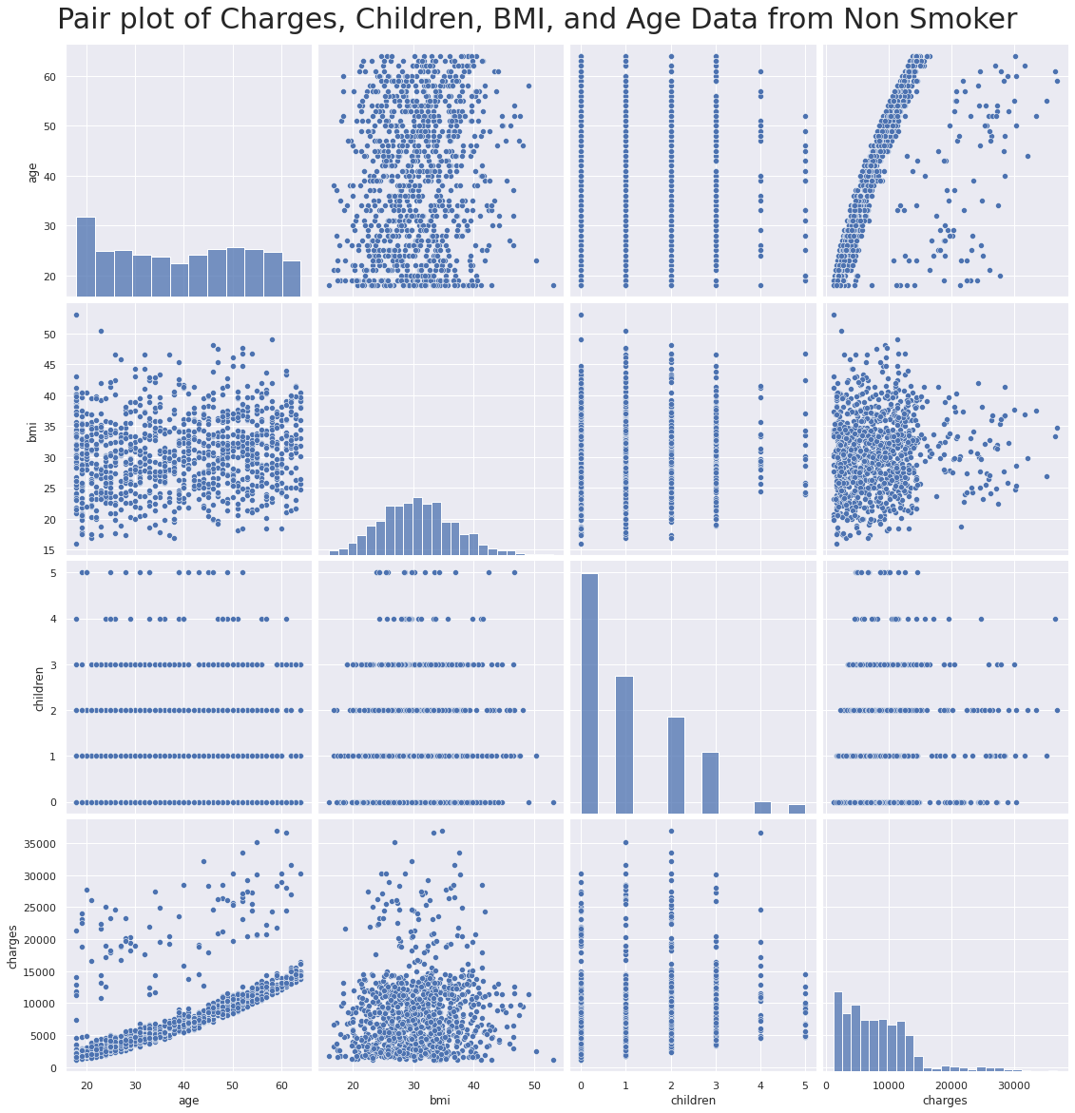
Non Smoker Correlation Analysis
Insight.
there are positive strong correlation between age vs charge for non-smoker, with a correlation value of 0.63
Notes:
This non smoker correlation analysis show us that there are strong correlation and pattern between age and charges.

Slide 30
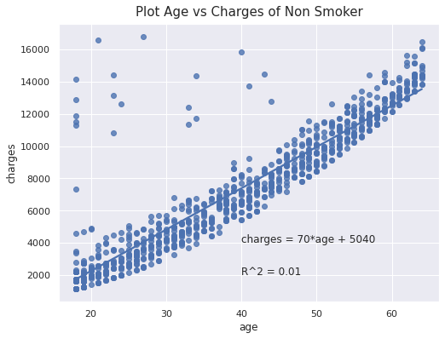
Non Smoker Correlation Analysis
Insight.
For non-smokers, if the age increased by one value, there will be an increase in charge by $70 dollars, this is relatively a low value to smoker data. With charges value ranged from around $1000 to $16000.
Compared to the smoker linear regression minimum value, non smoker indeed has cheaper insurance charge.
Notes:
Dig deeper into non smoker correlation analysis and create regression line we
found that if the age increased by one value, there will be an increase in charge by $70 dollars.

Slide 31
Correlation Analysis Summary
There is a correlation between smokers, non-smokers, BMI values, and age of insurance users to insurance charges that they have. Correlation analysis shows that people who smoke and have a high value of BMI tend to have an expensive insurance charge, the minimum charge value for them is $32500 and the value will increase by $480 dollars if the insurance user gets older. Smoker with middle to low-value BMI will have relatively cheaper insurance charges than smokers with high BMI values, the minimum charge for them is $12500 and the value will increase by $513 dollars if the insurance user gets older. Non-smokers, compared to smokers, have really cheap charges, their minimum value is around $1000 and the charges will increase by just $70 dollars if they get older. Then we could know that smoking and BMI really affects the expense of insurance charge.
Notes:
The summary of correlation analysis is :
there is a correlation between smokers, BMI, and age, also for non-smokers, and the strength is vary.
Correlation analysis shows that people who smoke will have more expensive insurance charges compared to other insurance charges.
From this analysis, we know that smoking is higher factor that makes charges expensive, compare to BMI and age

Slide 32
Hypothesis Testing
Notes:
The last part of this analysis is hypothesis testing

Slide 33
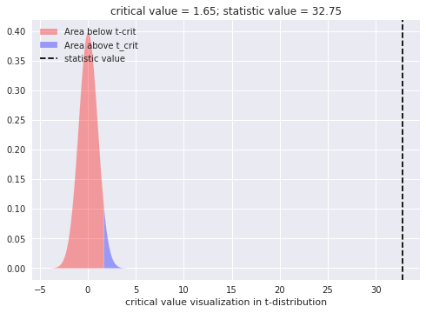
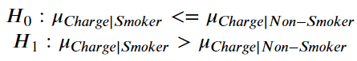
Smoker’s charges are higher than non-smoker’s
Insight.
Reject H0, hence in a population of insurance users, we are 95% confident that smoker’s insurance charges are higher than non-smoker insurance charges
Notes:
The first hypothesis to be tested is “Smoker’s charges are higher than non-smokers”.
The result is , with a confidence level of 95%,
in a population of insurance users
smoker’s insurance charges are higher than non-smoker insurance charges

Slide 34
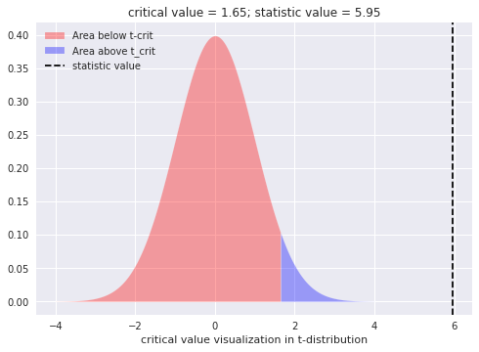
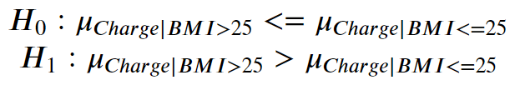
Insurance charges with BMI > 25 is higher than insurance charges with BMI < 25
Insight.
Reject H0, hence in a population of insurance users, we are 95% confident that users with BMI more than 25 will have more expensive charges than users with BMI less than 25.
Notes:
The second hypothesis to be tested is “Insurance charges with BMI more than 25 is higher than insurance charges with BMI less than 25”.
The result is,
with a confidence level of 95%,
in a population of insurance users
person with a BMI more than 25 will have more expensive insurance than people with a BMI less than 25.

Slide 35
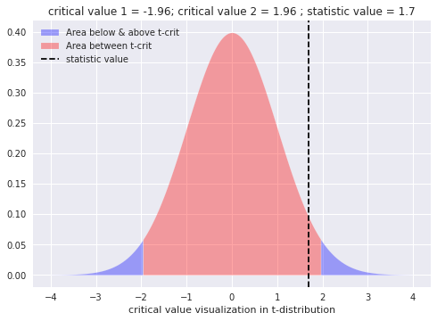
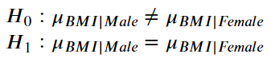
Male and Female BMI is similar
Insight.
Fail to Reject H0. Hence we are 95% confident that there is not enough data/evidence to prove that in a population of insurance users Male BMI is similar to Female BMI.
Notes:
The third hypothesis to be tested is “male and female BMI is similar”.
The result is, with a confidence level of 95%,
there is not enough data/evidence to prove that in a population of insurance users
Male BMI is similar to Female BMI.

Slide 36
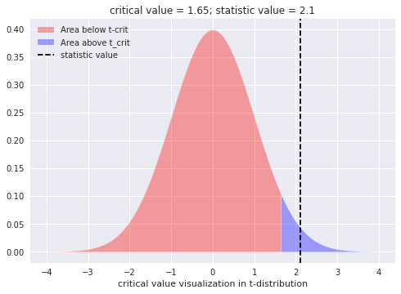
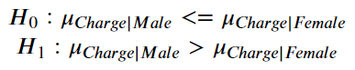
Male insurance charges are higher than female insurance charges
Insight.
Reject H0, hence in a population of insurance users, we are 95% confident that male insurance charges are higher than female insurance charges.
Notes:
The last hypothesis to be tested is “Male insurance charges are higher than female insurance charges”.
The result is,
with a confidence level of 95%,
in a population of insurance users
male insurance charges are higher than female insurance charges.

Slide 37
Conclusion
Notes:
Finally we reach the conclusion part

Slide 38
Analysis Summary
There are several factors that affect insurance user charges determination like smoking, BMI value, age, gender, region, and the number of children in a family. Of those factors, the most key factor to determine how expensive insurance charges will users have is the smoking habit. Analysis shows that people who smoke will get insurance charges higher than people who don’t smoke, the charges for smokers are around $18750 for smokers with relatively a good value of BMI, and around $40000 for smokers with a bad value of BMI. Whereas insurance charges for non-smokers are just around $4000. BMI also becomes the second most contributing factor for insurance charge determination, but the BMI contribution to charges determination is larger in smoker people. The analysis also shows that as people get older, the insurance charge is getting expensive, this age factor is also different in smokers and non-smokers people. The rest of the factor such as gender, region, and the number of children in a family does contribute to the determination of insurance charge but the value is very small compared to smoking, BMI, and age factor.
Notes:
So the summary of our insurance charge analysis is,
there are several factors affecting insurance user charges determination
like, smoking, BMI, age, gender, region, and children.
The key factor to determine how expensive the insurance user is if they are smoking,
because the charges of smokers is absolutely more than 18750 (eighteen thousand seven hundred and fifthy) dollars.
Then second most contributing factor is BMI, and the third is age of the insurance users.

Slide 39
Reference
Probability and Statistics for Engineers and Scientist, Ronal E. Walpole et. All
Pacmann : Intro to Probability Learning Module
Exploratory and Data Analysis Document
Notes:
This is my reference for completing this analysis

Slide 40



Slide 41


Slide 42
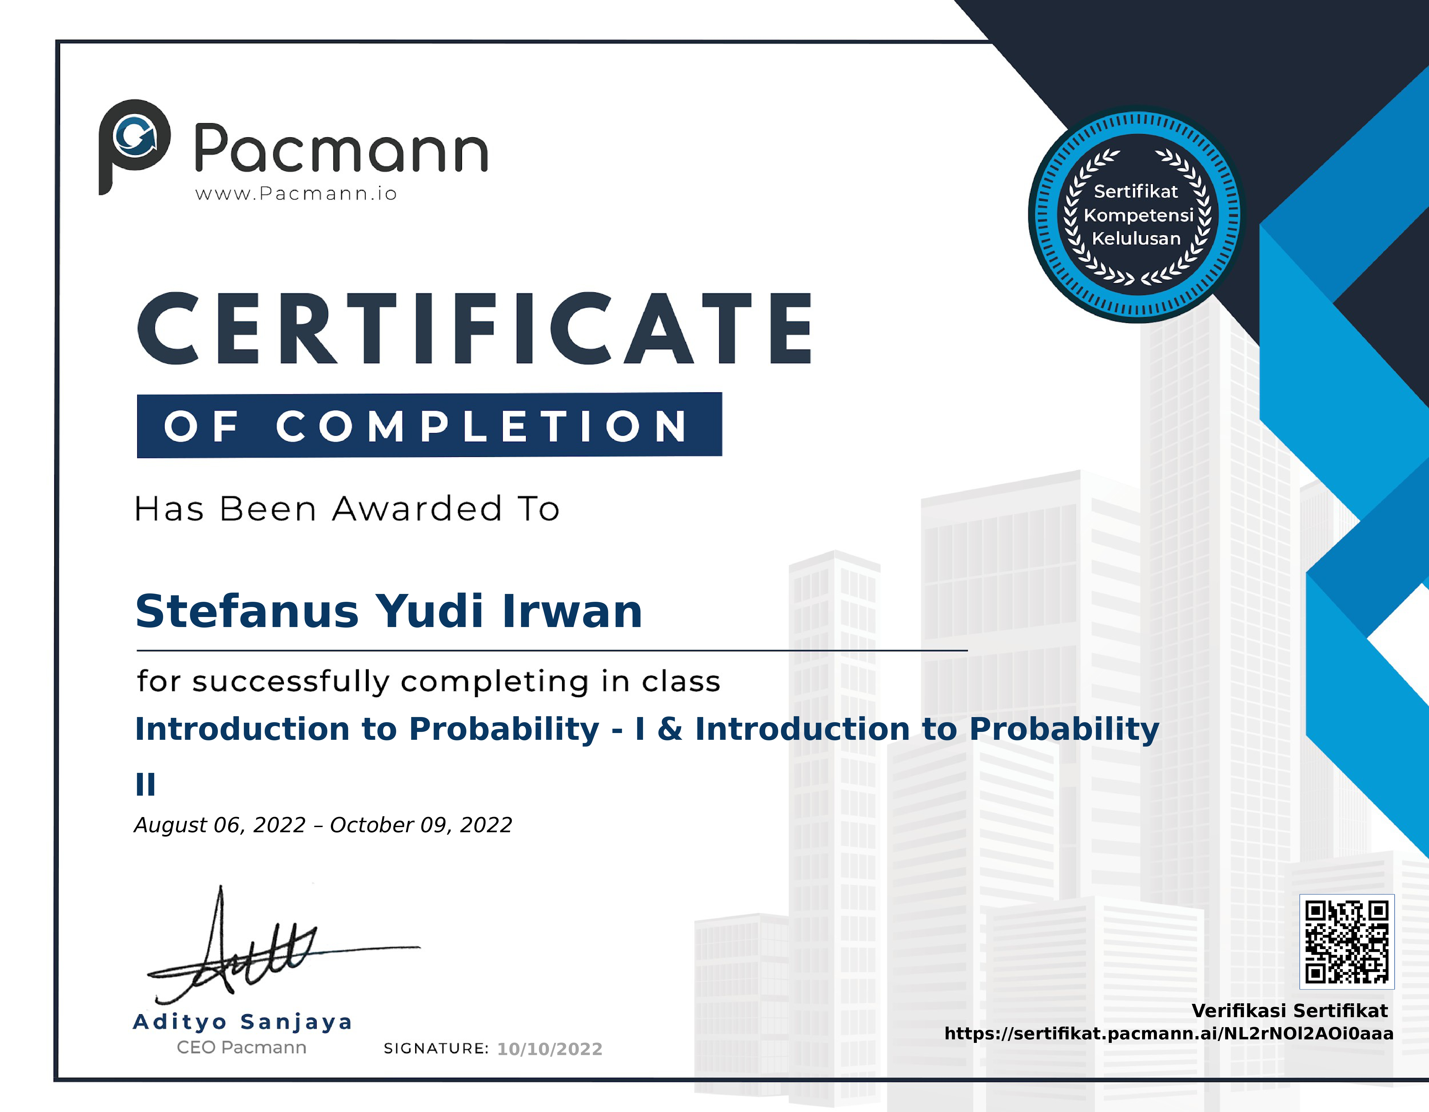

Slide 43







Project Notebook, Repository, & Presentation
Reach me !
For discussion
Project-Notebook
My-Resume
Project-Repository
My-Email
Kaggle-Repository
My-LinkedIn
YouTube Presentation

